Slide 1
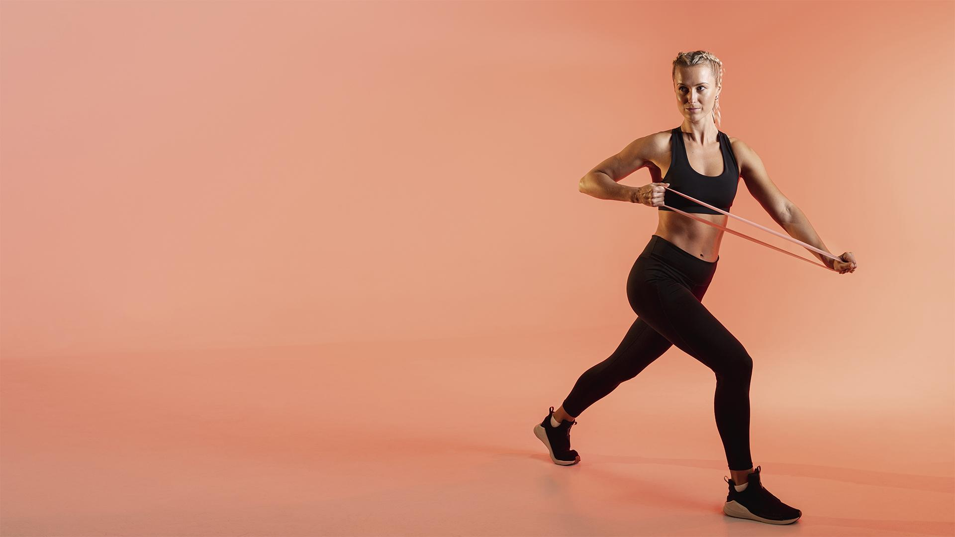
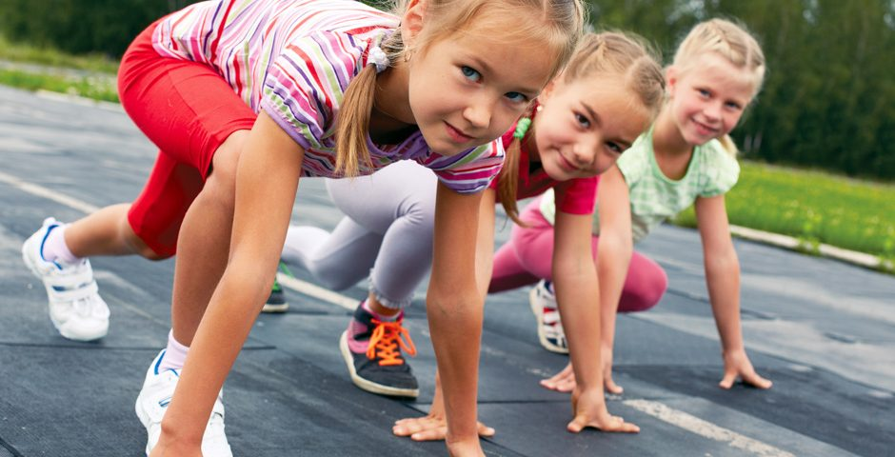
FITNESS APP
Motoric skills development
Made by:
Lisa Dumaij 19049838
Yuliya Litvin 20161417
Mustafa Mousa 18068987
Pascal Seegers 21132844
Joost van Viegen 18048757
Joep van der Zanden 19134282
Here is where your pitch deck begins

Slide 2
What we have done
01
Made some models
Created one file
Recieved T1 data
Collected CBS data

Slide 3
Model scores
Models | Testing score
Networking | 0.48
Random Forest | 0.79
Lasso | 0.51
K-Means | - - -
KNN | 0.84

Slide 4
02 Next steps
Include the T1 data
Create a heatmap
Balance the data
Try more models
Notes:
We have received the T0 data, but we are still waiting for the T1.
The data files we received have been combined into a single file.
We have explored the data using multiple visualisations

Slide 5
03 Doubts
Do we need the CBS data?
How can we split the data for the heatmap?

Slide 6
THANK YOU!

